Slide 1
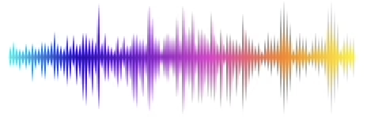
Voice Recognition David Birney Drake Brewer Dan Hansen

Slide 2

THE CHALLENGE
Goal:
Identify who is currently speaking using machine learning models
Problem:
Identifying individuals based on real time audio input presents several challenges
Background noise
Varying acoustic environments
Variations in speech patterns, volume, and intonation
Real World Applications:
Dictations systems
Voice activated assistants such as Siri, Alexa, and Google Assistant
Voice authentication and security
Targeted focus and highlighting of current speaker used in applications such as Teams and Zoom

Slide 3
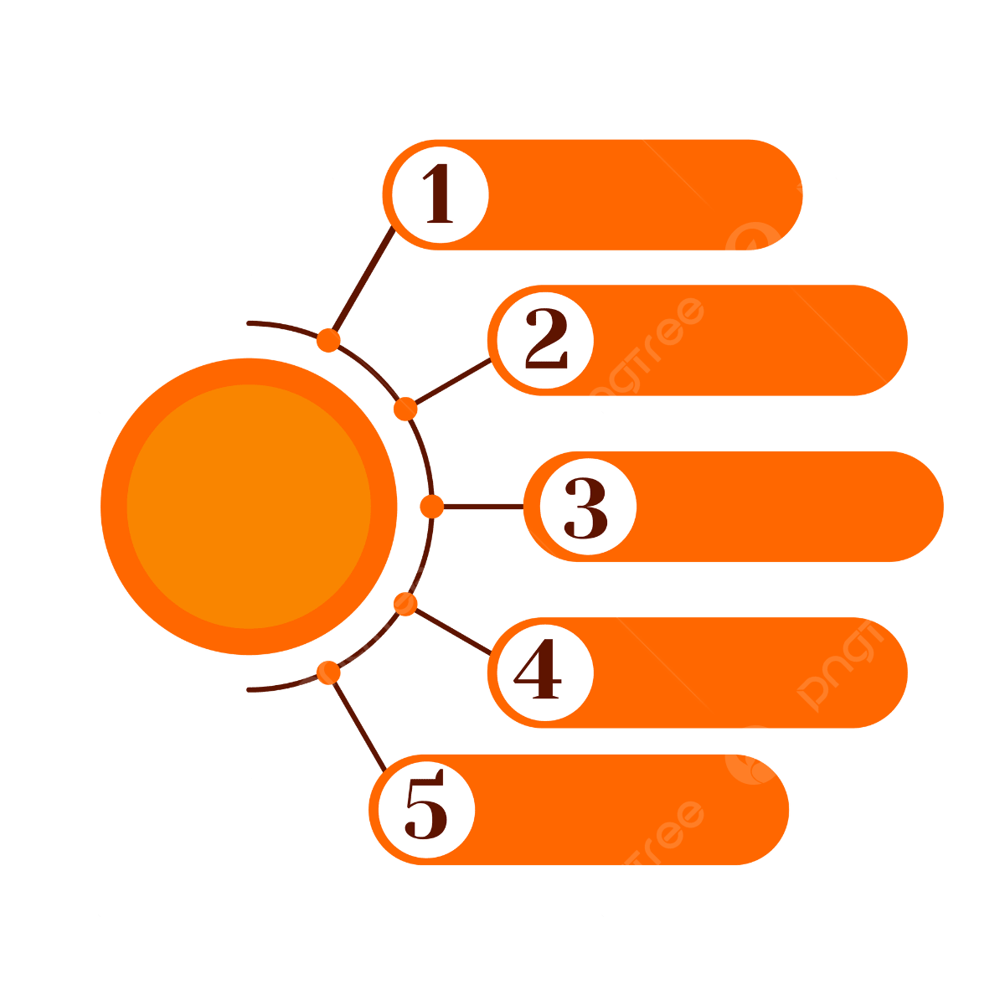






THE APPROACH
Collect Data
Extract Features
Train Model
Optimize
Predict

Slide 4

AUDIO COLLECTION
Step 1: Collecting training data for the model
Audio collected from 6 separate individuals
Approximately 10 minutes of audio per person
Recordings consist of
Passages from various books
Lyrics
Tweets
News Articles
Natural Conversation
Recording conditions
Laptop microphone in a quiet room
Recording method chosen to most closely simulate live demonstration conditions

Slide 5
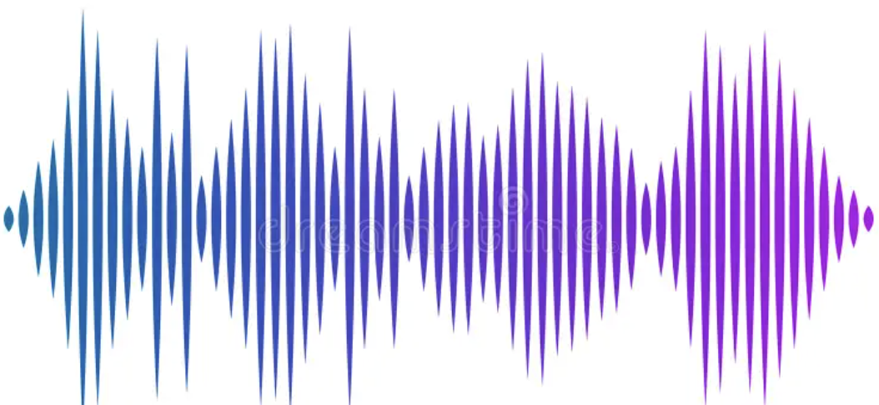
FEATURE EXTRACTION
Step 2: Extracting useful features from the audio
Tools and Processes:
Librosa audio library - converts
Raw audio ➜ feature vectors
Windowing:
Split audio waveform into 1 second windows
50% overlap to preserve continuity
Each window = 1 row of data
Final data frame ➜ 7898 x 49
Feature | What It Measures
MFCC | Timbre / vocal-tract shape
Chroma | Harmonic / pitch content
ZCR | Noisiness & consonant sharpness
RMS Energy | Volume
[ mfcc1, mfcc2, ... , chroma1, ... , contrast1, ... , rms, zcr ]
↓
[0.1, 0.2, …, -0.4, …, -0.2, …, 0.05, 1.2]

Slide 6
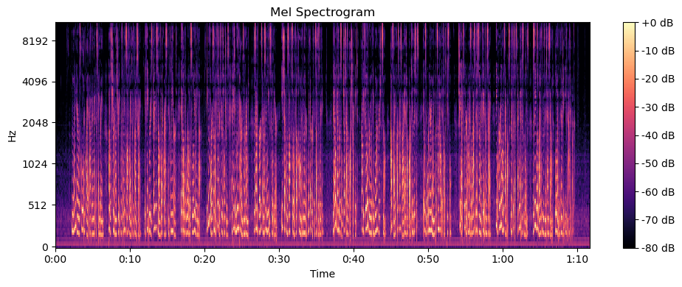
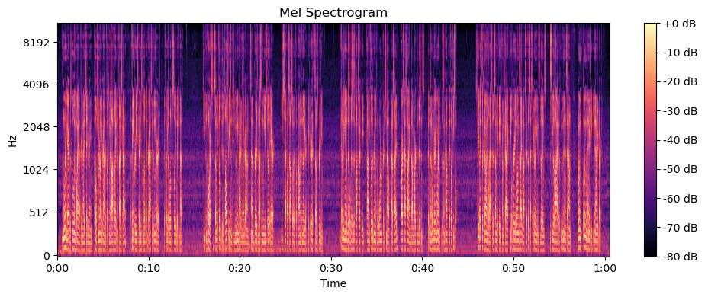
AUDIO VISUALIZATION - MEL SPECTROGRAM
Lisa →
Drake →

Slide 7


TRAINING THE MODEL
Step 3: Model Training
We used ‘Support Vector classifier’ in a 3-step pipeline
Scales all features so that large values do not dominate
Picks the most meaningful features
SVC classifier:
Finds optimal boundaries between classes
Suited for high-dimensional, non-linear data such as audio
svc_pipe = Pipeline([
('scaler', StandardScaler()),
('selector', SelectKBest(mutual_info_classif, k="all")),
('classifier', SVC(probability=True))
])

Slide 8

OPTIMIZING PARAMETERS
Step 4: Optimization
What we tried:
Several classifiers (RF, GB, SVC)
GridSearchCV
Increasing the dataset
Cross validation ➜ GroupKFold
Randomized audio content and environments
svc_grid = {
"selector__k": [30, 40, "all"],
"classifier__C": [10, 25, 35],
"classifier__gamma": ["scale", "auto", 0.1],
"classifier__kernel": ["rbf", "poly"],
"classifier__degree": [2, 3]
}

Slide 9

EVALUATING THE MODEL
Best F1: 0.7746556
Best Params:
{
'classifier__C': 10,
'classifier__gamma': 'scale', 'classifier__kernel': 'rbf',
'selector__k': 'all'
}
‘classifier_kernel’: ‘rbf’
maps data into higher dimensionality space
‘classifier__C’: 10
punishment for misclassifying
‘classifier__gamma’: ‘scale’
how wide margin around each data point (‘scale’ = low)
‘selector__k’: ‘all’ = kept all features

Slide 10
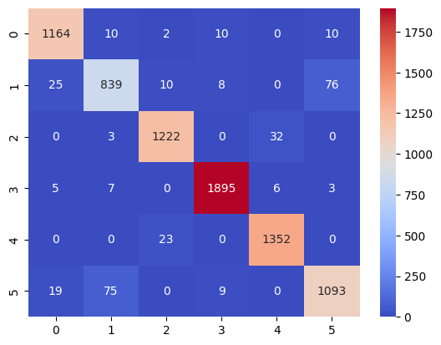
CONFUSION MATRIX

Slide 11
KEY TAKEAWAYS
Lessons Learned:
Not enough data to train the model
With audio models, more data is better
Inconsistent recordings
Differences in recording methods and environment can affect model performance
Folds split by row overlap ➜ leads to leakage between train/test sets
F1 score suspiciously high
Solution - GroupKFold
Final Thoughts:
Voice recognition can be challenging and finicky
Quite a few variables to consider
Data quality is extremely important for accurate results
With careful data collection, cleaning, training, and evaluation ML models can reliably identify speakers in real world settings

Slide 12

